Slide 1
SWAMPY FROG GAMES
My Final Project for HCI

Slide 2
PROBLEM ANALYSIS
A problem that I myself has been seeing these past couple of years is that Indie games don’t sell very well leading to indie game developers quitting their careers to join megacompanies
↓
This is occurrence is supported by several factors such as
↬ Massive game corporations tend to overshadow these indie corporations and games
↬ Since the specialty of video game developers isn’t marketing, there isn’t any way that we can ensure that they can market their games properly
↬ Not only that, people who develop video games tend to promote them in various places such as Instagram, facebook, etc which isn’t a place people go to find video games

Slide 3
↓
This results in the video games to not sell properly, which doesn’t look good for the lives of these developers
↓
Because of this, video game developers would quit on their dreams of creating their dream games
↓
In order to prevent this I’ve decided to make a platform that is meant to house thousands of indie video games in order to promote such games
↓
By doing so, these indie developer might get more recognition thus reviving their games and careers

Slide 4

Persona: Will Shlatner
Will Shlatner
↬ Age: 18
↬ Profession: college student / part time barista
↬ Hobbies: gaming, streaming, hanging out with friends, listening to music,
↬ likes: video games, rock music, cold brew coffee, Sci-Fi, Mythology
↬ dislikes: Frat Parties, Large Crowds, Pop Music
Will trying to go to go home after a lecture

Slide 5
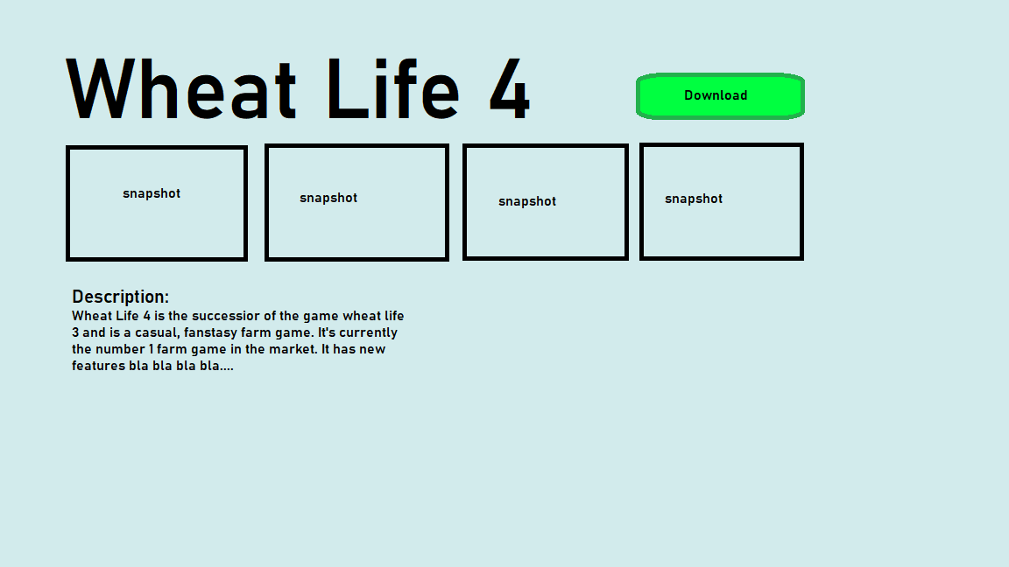
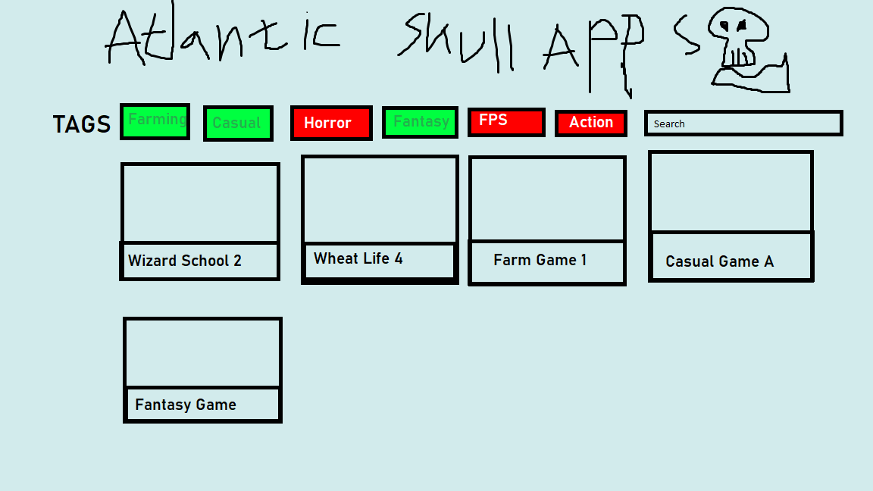
PROTOTYPE
First Rendition
↬ The first rendition of the prototype consists of two designs, which are the “app description” tab and the “main menu” tab.

Slide 6
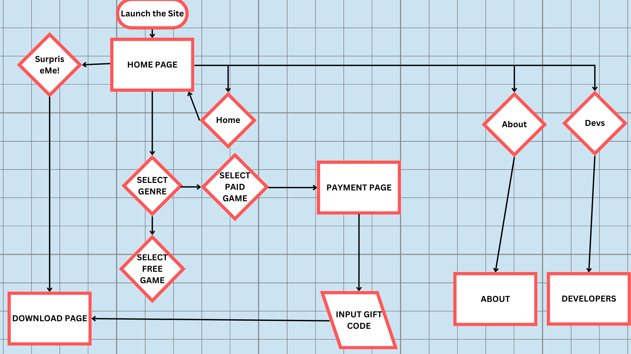
Diagram(flowchart)

Slide 7
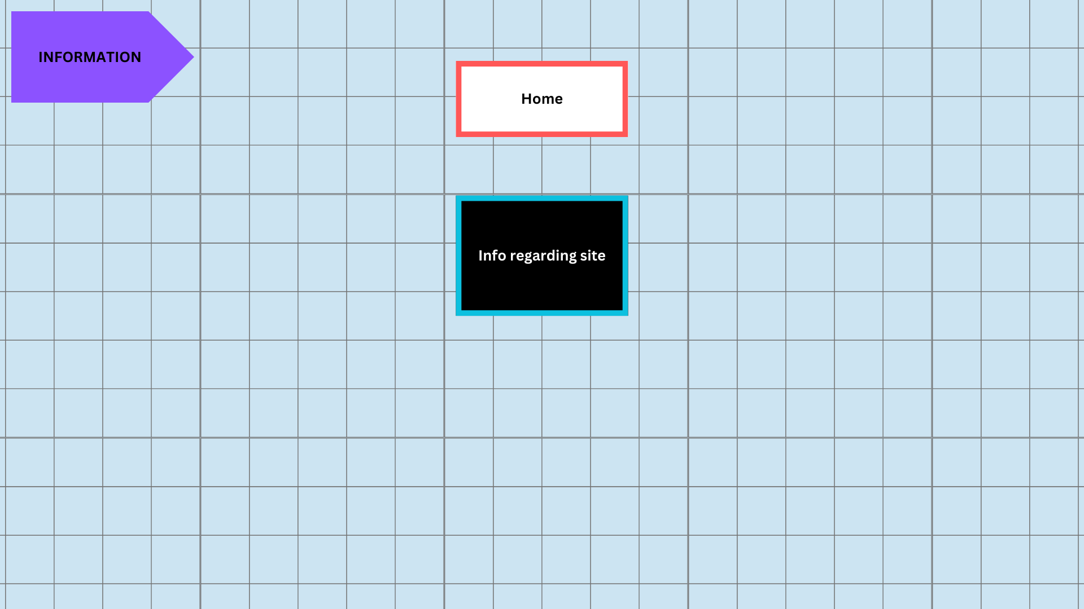
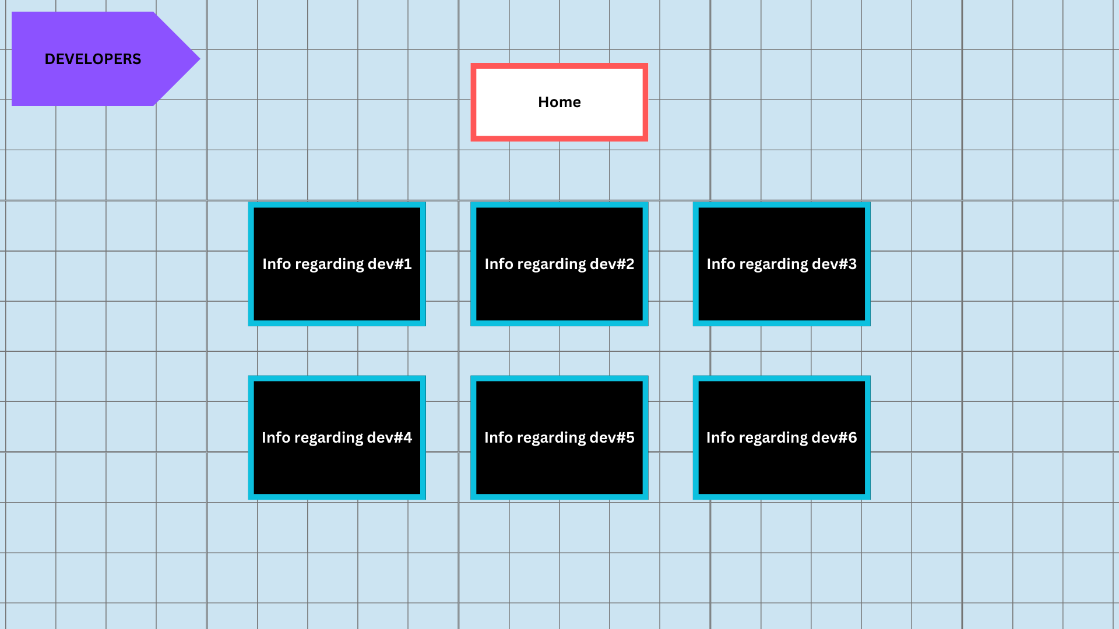
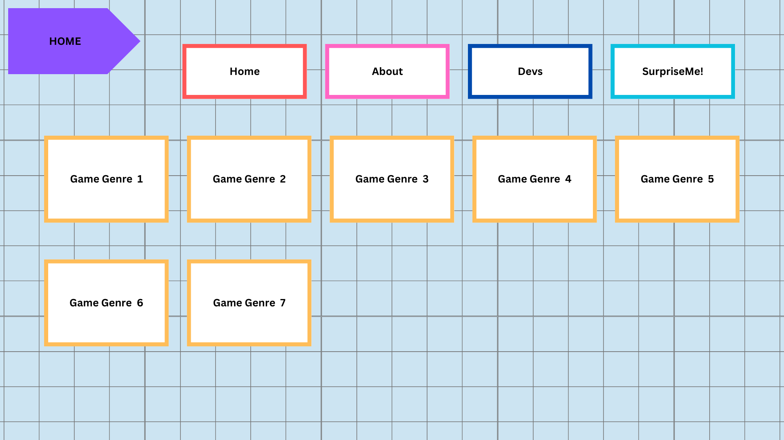
Wireframe
The home page is where you enter the page and is greeted with options on the upper tab and an assortment of game genres you can choose from
The developer page is where you find the developers for the website, which are people who also published games in the same website
The about page is where information regarding the site itself is stored

Slide 8
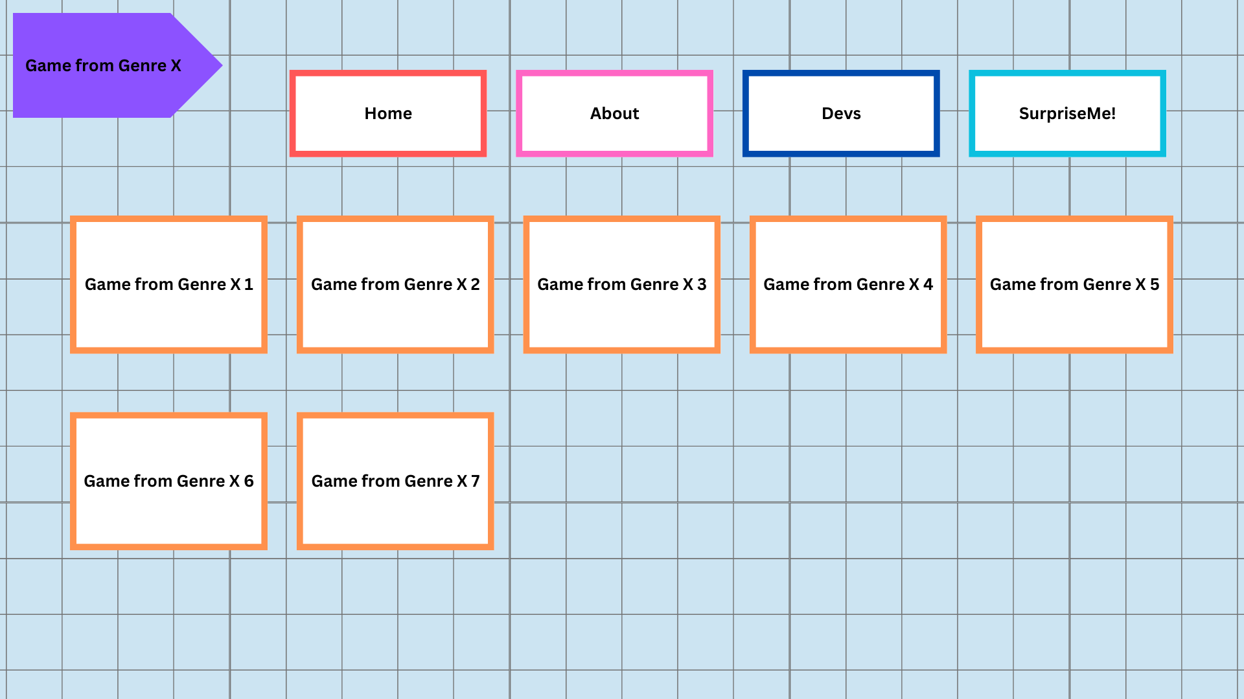
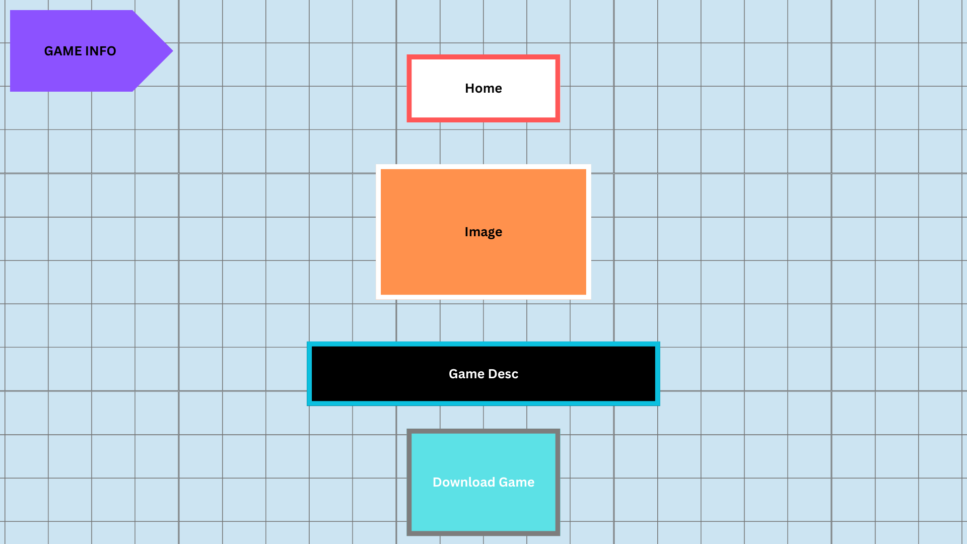
wireframe
The genre page is where you find games of a genre once a genre is selected from the home page
The purchase page is where purchases are made if a selected game costs a sum of money
The download or game info page is where you get brief information about a game and is where you can download it

Slide 9
Website showcase
Now, I will show you my website

